Slide 1




TEAM ALPHA
Akilesh Vishnu
Arjun
Soumya
Abilash
Company: HOPPER
Objective: CUSTOMER SATISFACTION

Slide 2





PROBLEM STATEMENT
Hopper excels at predicting deals yet falters in post-booking service, leading to customer churn. Users often consult the service for best price predictions but don’t go ahead with booking, undermining loyalty and retention.

Slide 3



VISION
To redefine travel convenience by ensuring not only the most predictive savings on bookings but also by elevating customer satisfaction to positive travel experiences and fostering lasting customer loyalty

Slide 4



Meet Hopper's Travelers!
Power User
(Mileage Master)
Casual User
Core User
(Price-Savvy)
(Occasional Explorer)
Travels a few times a year for leisure
Looking for best travel deals
flexible with dates (+/- a few weeks)
Open to a variety of travel experiences
Travels frequently, limited date flexibility.
Books efficiently, prioritizes comfort and minimizes disruptions.
Analyzes data, finds deals on specific routes
Works full-time
Travels occasionaly with family and friends
Prefers comfortable flights with predictable schedules
Mia, 26 yrs
Travel Enthusiast
Michael, 48 yrs
Business Traveller
Emily, 44 yrs
Doctor

Slide 5

Market Size (User Base)
TAM
3 Billion
SAM
700 Million
SOM
40 Million

Slide 6


Competitor Analysis
OTA Space
PUSH NOTIFICATION
WATCH
LIST
PRICE
ALERTS
PRICE FREEZE
GENERATIVE AI
SUPPORT
Hopper
Expedia
Kayak
Priceline

Slide 7







User Pain Points
Hopper Customer
Support Process
VIP Support = Pay for Premium support
Phone Support = Wait on Que
Chat Support = Responses not helpful
Email Support = Delayed responses
Timely Support
Price Fluctuations
Inadequate Customer Service
Refund and Cancellation Policy issues
Reliabilabity and Trust

Slide 8
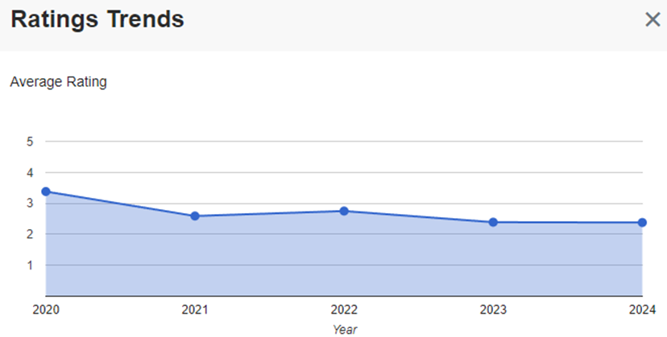
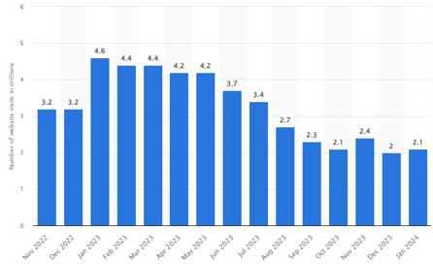
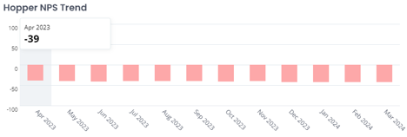
User Survey Analysis
2.5%
Positive Review Rate
Rating =2.3
Users =2.1 m
NPS = -44

Slide 9

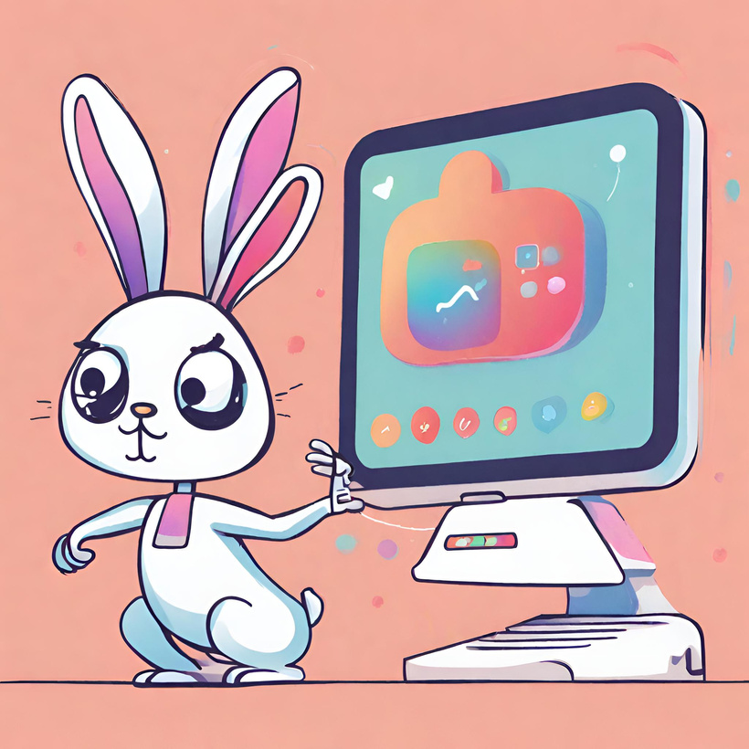
Solution
Leveraging Generative AI in Customer Support

Slide 10


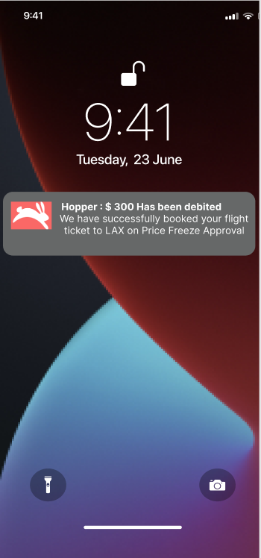
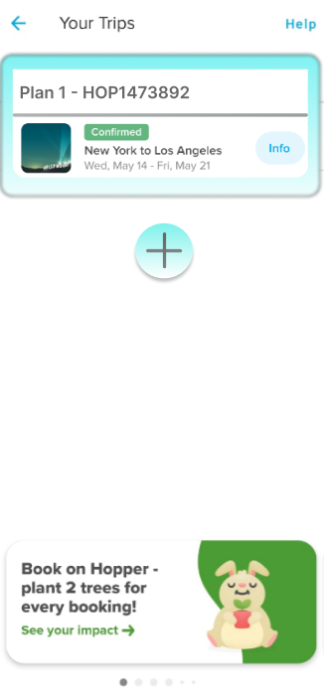
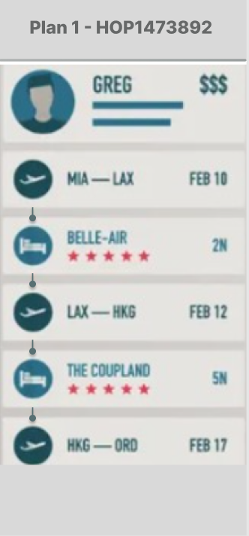
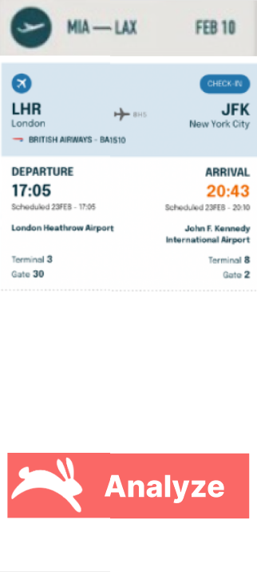
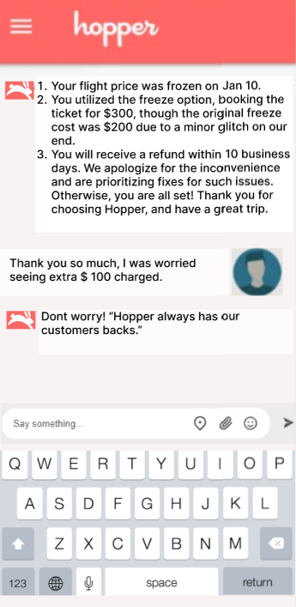

New Feature User Flow
Incorporating Generative AI

Slide 11
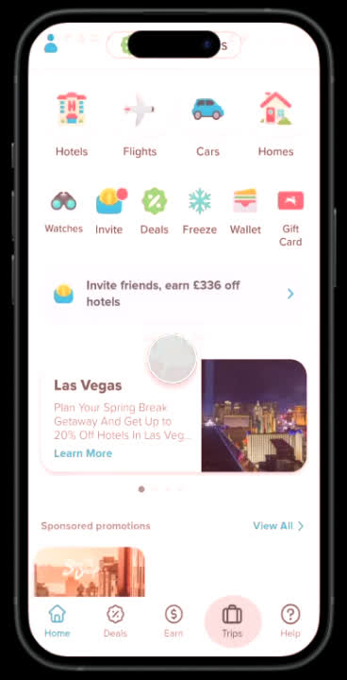


Our Prototype MVP
https://www.figma.com/proto/CwQfM22e7PHpUArkzPLz6Q/Team_Alpha?type=design&node-id=62-75&t=tovbOhyJ7pPSzz3B-0&scaling=scale-down&page-id=11%3A2&starting-point-node-id=62%3A75

Slide 12
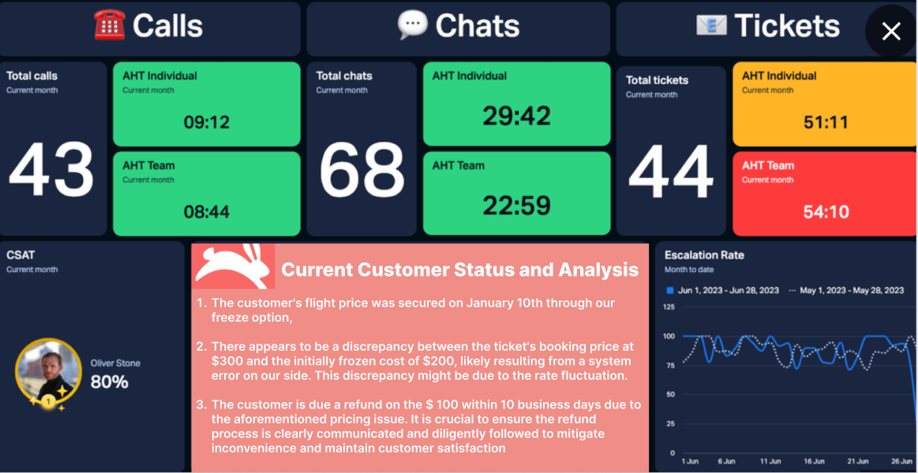
Customer Service Dashboard
Incorporating Generative AI

Slide 13


Feature Prioritization: Kano Model
Delighted
Auto-Resolution
Delighters
Attractive
Personalization
Must-Be
Speed
Present
Present
Accuracy
Security
Satisfaction

Slide 14



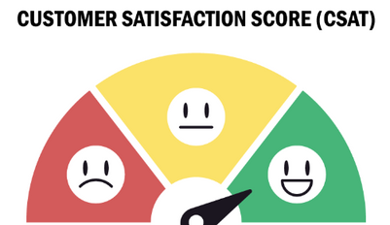
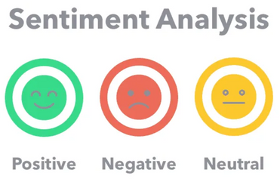
Metric Considered (Customer Satisfaction)
Counter Metric
North star Metric
Vanity Metric

Slide 15
Product Roadmap
Teams
1st Quarter
2nd Quarter
3rd Quarter
4th Quarter
Project Scope and benchmarks
Research and Planning
User Research
UI/UX Design
Design and
Prototyping
Usability Testing
Development,
Testing,Deployment
Build Features, Develop Algorithms & Integrate AI
Production Release
Testing and Hypothesis
Support and
Monitoring
Support Training, Monitoring and Feedback Loop

Slide 16


Hopper Targets 2025
NPS Score = 25% increase
Active Users = 30 million
Growth Rate = 7% CAGR
AI Support model = Accuracy (85%)

Slide 17



